Slide 1

ZEROTH REVIEW Balancing Accuracy and Interpretability: A Post-hoc Explainable AI Framework for Structured Data Project Category: RESEARCH
Guide Name: Dr. Dinesh G Student Name & Registration Number:
Vignesh R – RA2311047010165
Sarvesh Raam T K – RA2311047010177

Slide 2
Abstract
The growing adoption of machine learning models in real-world decision-making systems has raised critical concerns regarding transparency and interpretability. While complex models often achieve high predictive accuracy, their black-box nature limits trust, accountability, and practical deployment in sensitive domains such as healthcare and socio-economic assessment. This project presents a post-hoc Explainable Artificial Intelligence (XAI) framework aimed at balancing predictive performance and interpretability for structured data. Multiple classification models, including Logistic Regression, Random Forest, and Gradient Boosting, are trained and evaluated on benchmark datasets such as the UCI Adult Income and UCI Heart Disease datasets. Model-agnostic explanation techniques, namely SHAP and LIME, are employed to generate both global and local explanations of model predictions. The experimental analysis demonstrates that ensemble models provide superior accuracy, while explainability techniques offer meaningful insights into feature importance and individual prediction reasoning. The study highlights the trade-off between accuracy and interpretability and emphasizes the role of explainable AI in building trustworthy and transparent machine learning systems for real-world decision support.

Slide 3
Introduction
Machine learning models are increasingly used in real-world decision-making systems such as healthcare diagnosis, financial risk assessment, and socio-economic evaluation. Although advanced machine learning models often achieve high predictive accuracy, they function as black-box systems, making it difficult to understand how predictions are generated. This lack of transparency reduces trust and limits their adoption in critical applications.
Explainable Artificial Intelligence (XAI) has emerged as a solution to address this challenge by providing insights into model behaviour without compromising performance. XAI techniques help users understand the influence of input features on predictions, enabling transparency, accountability, and informed decision-making.

Slide 4
Introduction
In this project, a post-hoc explainable AI framework is proposed to analyse and interpret machine learning predictions on structured datasets. Multiple classification models are trained and evaluated, and model-agnostic explanation methods such as SHAP and LIME are applied to provide both global and local interpretability. The study focuses on analysing the trade-off between model accuracy and interpretability, highlighting the importance of explainable AI for building trustworthy machine learning systems.

Slide 5
Introduction
SHAP (SHapley Additive exPlanations)
SHAP is a post-hoc explainability technique based on cooperative game theory. It assigns an importance value to each input feature by measuring its contribution to the model’s prediction. SHAP provides both global explanations, which show overall feature importance across the dataset, and local explanations, which explain individual predictions. It ensures consistency and fairness in feature attribution, making it widely used for interpreting complex machine learning models.
LIME (Local Interpretable Model-agnostic Explanations)
LIME is a model-agnostic explainability method that explains individual predictions by approximating the black-box model locally with a simple interpretable model. It perturbs the input data around a specific instance and observes the changes in predictions to identify influential features. LIME focuses only on local interpretability, helping users understand why a particular prediction was made.

Slide 6
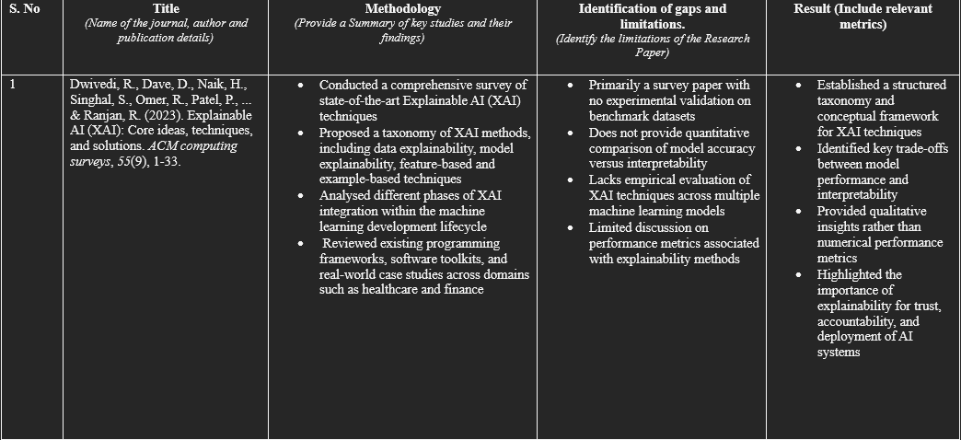
Literature Survey

Slide 7
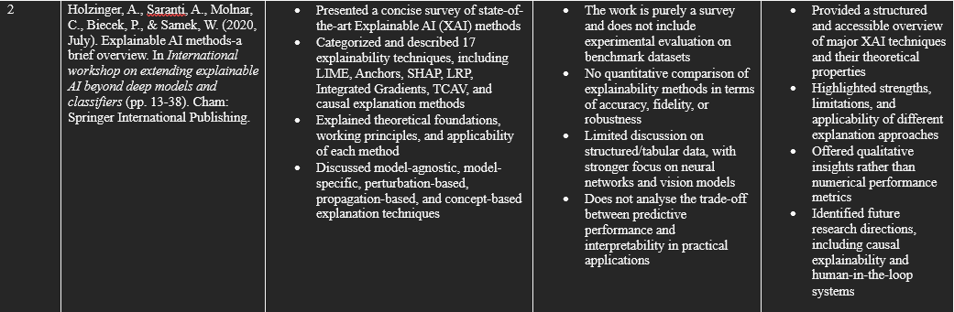
Literature Survey

Slide 8
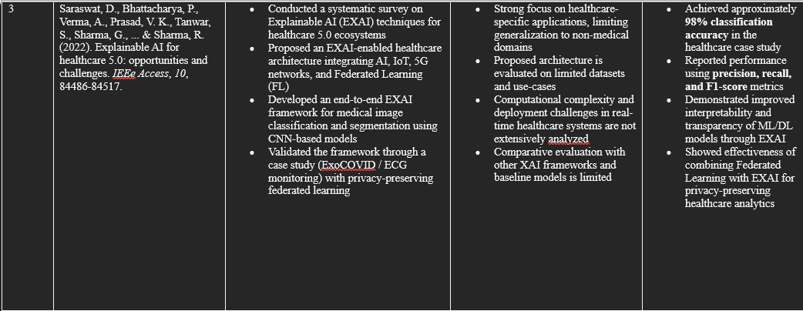
Literature Survey

Slide 9
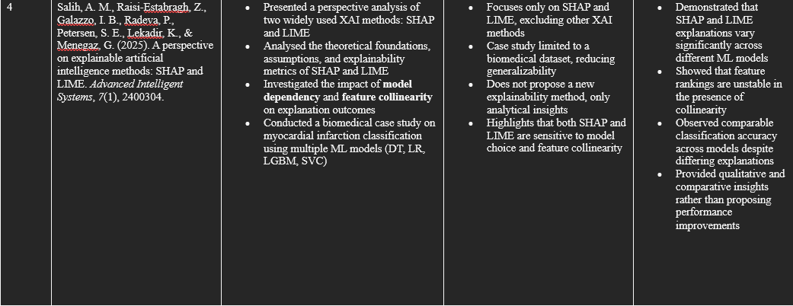
Literature Survey

Slide 10
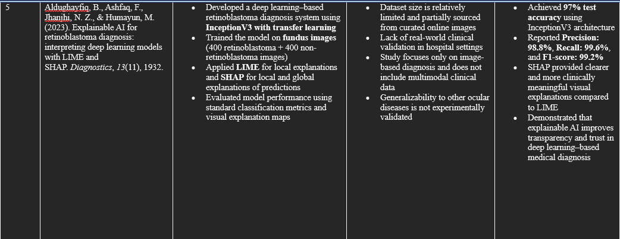
Literature Survey

Slide 11
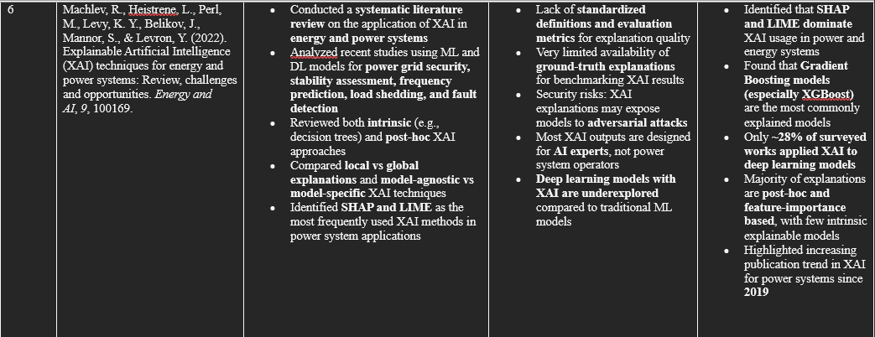
Literature Survey

Slide 12
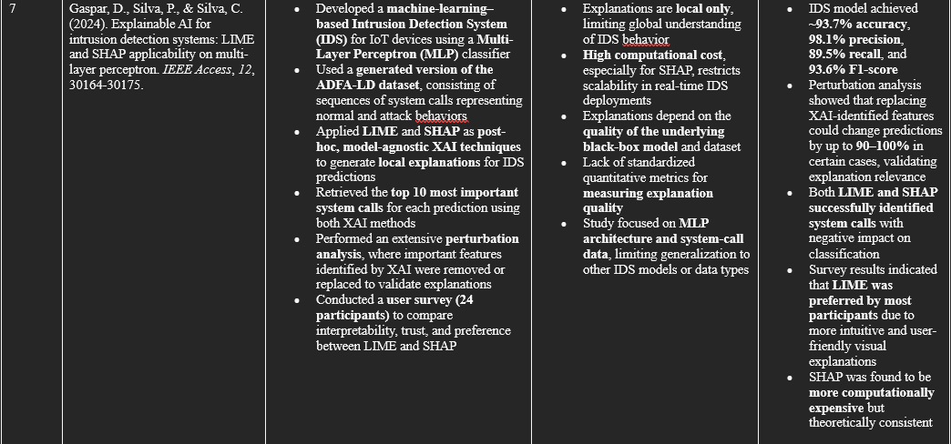
Literature Survey

Slide 13
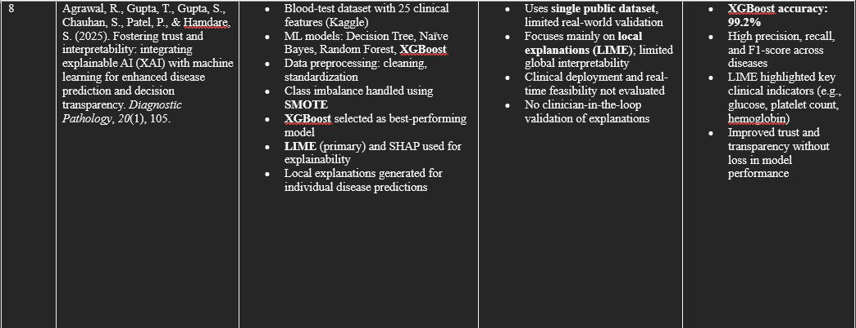
Literature Survey

Slide 14
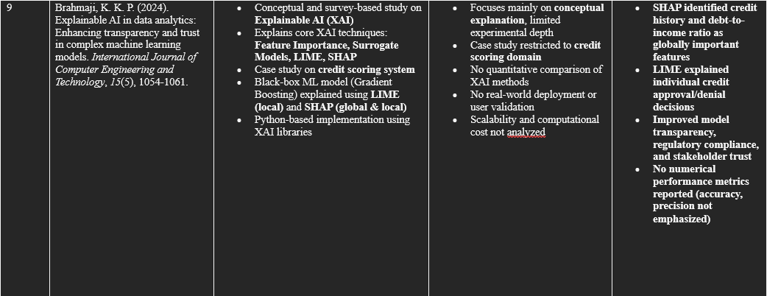
Literature Survey

Slide 15
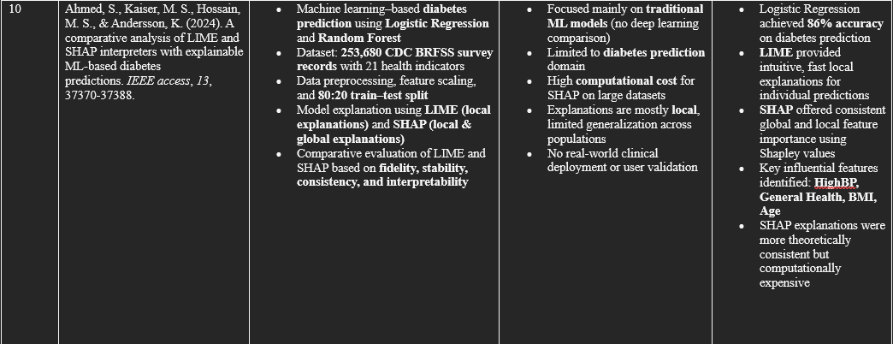
Literature Survey

Slide 16
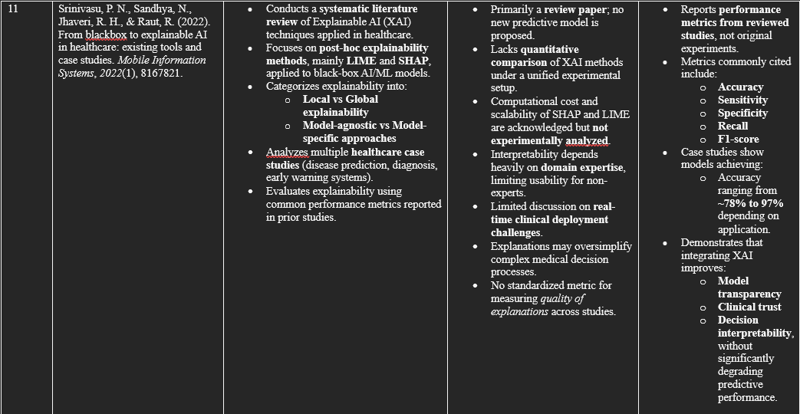
Literature Survey

Slide 17
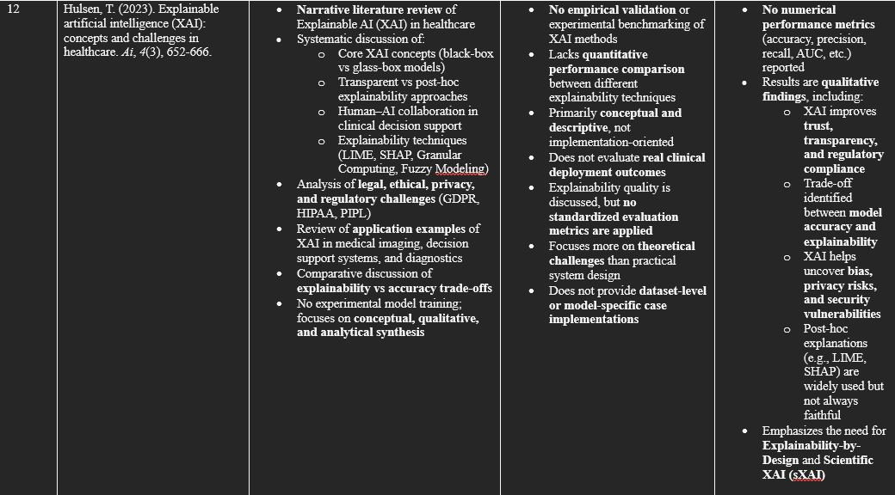
Literature Survey

Slide 18
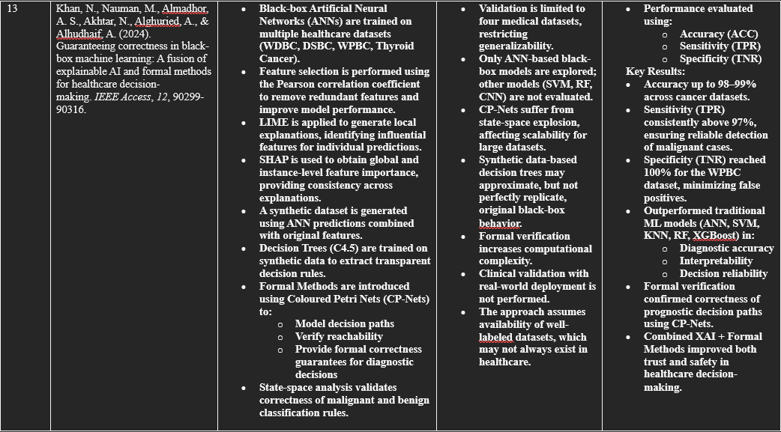
Literature Survey

Slide 19
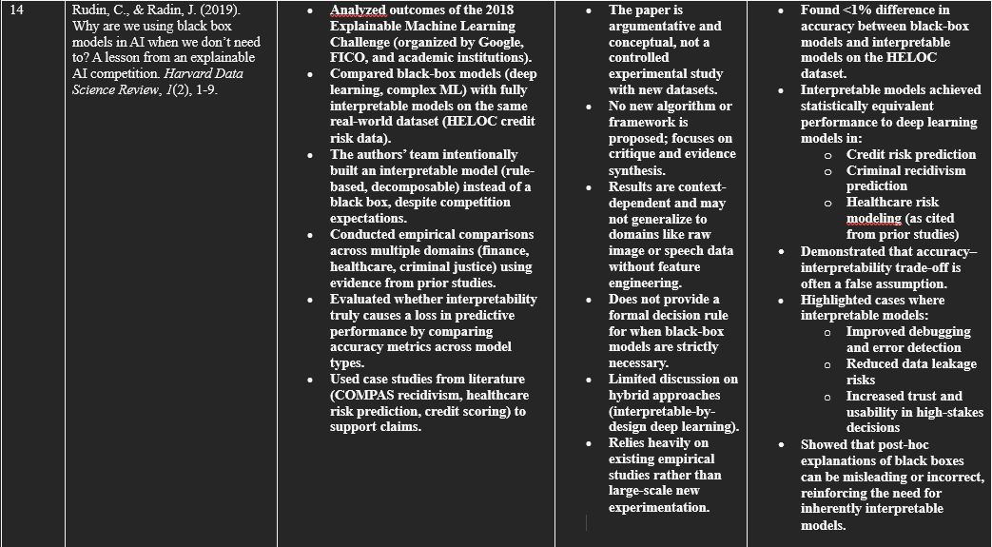
Literature Survey

Slide 20
Research Gaps
Existing XAI methods (LIME, SHAP, surrogate models) focus mainly on post-hoc explanations and do not guarantee the correctness or faithfulness of explanations to the actual model behavior.
Most studies emphasize interpretability and visualization, but lack mechanisms to formally validate or verify the reliability of explanations in high-stakes healthcare decisions.
Limited research integrates explainability with correctness assurance, especially for black-box machine learning models used in clinical decision support systems.
Trade-offs between accuracy, explainability, and trust are not adequately addressed, restricting real-world clinical adoption of XAI systems.

Slide 21
Objectives
To study the importance of Explainable Artificial Intelligence (XAI) in healthcare decision-making systems.
To analyze the limitations of black-box machine learning models in safety-critical medical applications.
To implement machine learning–based prediction models for healthcare data.
To apply LIME (Local Interpretable Model-Agnostic Explanations) to generate local explanations for individual predictions.
To apply SHAP (Shapley Additive Explanations) to generate global and consistent feature importance explanations.
To compare LIME and SHAP in terms of interpretability, stability, and clinical usefulness.
To improve model transparency, trust, and interpretability without significantly sacrificing prediction accuracy.
To demonstrate how explainable models can support clinicians in understanding and validating AI-driven decisions.

Slide 22
Justification of Project SDG
SDG 3: Good Health and Well-Being
The project directly supports SDG 3, which aims to ensure healthy lives and promote well-being for all at all ages.
By developing AI-based healthcare prediction models, the project contributes to early disease detection and risk assessment, enabling timely medical intervention.
The use of Explainable AI (XAI) techniques such as LIME and SHAP helps clinicians understand model predictions, reducing diagnostic uncertainty.
Improved transparency in AI systems enhances clinical trust, leading to safer and more reliable healthcare decision-making.
The project supports improved quality of healthcare services, especially in data-driven and AI-assisted diagnosis.

Slide 23
Justification of Project SDG
SDG 9: Industry, Innovation, and Infrastructure
The project promotes innovation in healthcare technology by integrating machine learning with explainable AI.
It addresses a key limitation of modern AI systems—black-box behavior—by introducing interpretable and transparent decision-making.
The research contributes to the development of responsible and trustworthy AI infrastructure suitable for deployment in real-world healthcare systems.

Slide 24
Plan of Action (Timeline)
Phase 1: Problem Identification & Literature Survey
Duration: Weeks 1–3
Identified the research problem in explainable AI for healthcare decision-making
Studied existing literature on XAI techniques (LIME, SHAP, surrogate models, formal methods)
Analysed limitations of black-box models in medical applications
Selected base paper and finalized research gap
Phase 2: Dataset Selection & Understanding
Duration: Weeks 4–5
Identified suitable healthcare datasets (e.g., cancer diagnostic datasets)
Studied dataset features, class distribution, and preprocessing requirements
Removed irrelevant attributes and handled missing values

Slide 25
Plan of Action (Timeline)
Phase 3: Model Development (Black-box Models)
Duration: Weeks 6–8
Implemented machine learning / neural network models for prediction
Trained and validated models using cross-validation
Evaluated baseline performance using accuracy, sensitivity, and specificity
Phase 4: Explainability Integration (XAI)
Duration: Weeks 9–10
Applied XAI techniques such as LIME and SHAP
Generated local and global explanations for model predictions
Identified important features influencing clinical decisions

Slide 26
Plan of Action (Timeline)
Phase 5: Correctness & Validation (Advanced Analysis)
Duration: Weeks 11–12
Compared explainability outputs with model behaviour
Validated consistency of explanations
(If applicable) Integrated surrogate models / formal reasoning for decision verification
Phase 6: Result Analysis & Evaluation
Duration: Weeks 13–14
Analysed performance metrics (Accuracy, Sensitivity, Specificity)
Compared results with existing approaches from literature
Studied strengths and limitations of the proposed approach

Slide 27
Plan of Action (Timeline)
Phase 7: Documentation & Presentation
Duration: Weeks 15–16
Prepared research paper / report
Designed PPT for review and final presentation
Finalized conclusions, future scope, and SDG justification

Slide 28
References
Ahmed, S., Kaiser, M. S., Hossain, M. S., & Andersson, K. (2024). A comparative analysis of LIME and SHAP interpreters with explainable ML-based diabetes predictions. IEEE access, 13, 37370-37388.
Dwivedi, R., Dave, D., Naik, H., Singhal, S., Omer, R., Patel, P., ... & Ranjan, R. (2023). Explainable AI (XAI): Core ideas, techniques, and solutions. ACM computing surveys, 55(9), 1-33.
Holzinger, A., Saranti, A., Molnar, C., Biecek, P., & Samek, W. (2020, July). Explainable AI methods-a brief overview. In International workshop on extending explainable AI beyond deep models and classifiers (pp. 13-38). Cham: Springer International Publishing.
Saraswat, D., Bhattacharya, P., Verma, A., Prasad, V. K., Tanwar, S., Sharma, G., ... & Sharma, R. (2022). Explainable AI for healthcare 5.0: opportunities and challenges. IEEe Access, 10, 84486-84517.
Salih, A. M., Raisi‐Estabragh, Z., Galazzo, I. B., Radeva, P., Petersen, S. E., Lekadir, K., & Menegaz, G. (2025). A perspective on explainable artificial intelligence methods: SHAP and LIME. Advanced Intelligent Systems, 7(1), 2400304.
Aldughayfiq, B., Ashfaq, F., Jhanjhi, N. Z., & Humayun, M. (2023). Explainable AI for retinoblastoma diagnosis: interpreting deep learning models with LIME and SHAP. Diagnostics, 13(11), 1932.
Machlev, R., Heistrene, L., Perl, M., Levy, K. Y., Belikov, J., Mannor, S., & Levron, Y. (2022). Explainable Artificial Intelligence (XAI) techniques for energy and power systems: Review, challenges and opportunities. Energy and AI, 9, 100169.
Gaspar, D., Silva, P., & Silva, C. (2024). Explainable AI for intrusion detection systems: LIME and SHAP applicability on multi-layer perceptron. IEEE Access, 12, 30164-30175.

Slide 29
References
Agrawal, R., Gupta, T., Gupta, S., Chauhan, S., Patel, P., & Hamdare, S. (2025). Fostering trust and interpretability: integrating explainable AI (XAI) with machine learning for enhanced disease prediction and decision transparency. Diagnostic Pathology, 20(1), 105.
Brahmaji, K. K. P. (2024). Explainable AI in data analytics: Enhancing transparency and trust in complex machine learning models. International Journal of Computer Engineering and Technology, 15(5), 1054-1061.
Rudin, C., & Radin, J. (2019). Why are we using black box models in AI when we don’t need to? A lesson from an explainable AI competition. Harvard Data Science Review, 1(2), 1-9.
Srinivasu, P. N., Sandhya, N., Jhaveri, R. H., & Raut, R. (2022). From blackbox to explainable AI in healthcare: existing tools and case studies. Mobile Information Systems, 2022(1), 8167821.
Hulsen, T. (2023). Explainable artificial intelligence (XAI): concepts and challenges in healthcare. Ai, 4(3), 652-666.
Khan, N., Nauman, M., Almadhor, A. S., Akhtar, N., Alghuried, A., & Alhudhaif, A. (2024). Guaranteeing correctness in black-box machine learning: A fusion of explainable AI and formal methods for healthcare decision-making. IEEE Access, 12, 90299-90316.

Slide 30
References
Xu, F., Uszkoreit, H., Du, Y., Fan, W., Zhao, D., & Zhu, J. (2019, September). Explainable AI: A brief survey on history, research areas, approaches and challenges. In CCF international conference on natural language processing and Chinese computing (pp. 563-574). Cham: Springer International Publishing.
Goebel, R., Chander, A., Holzinger, K., Lecue, F., Akata, Z., Stumpf, S., ... & Holzinger, A. (2018). Explainable AI: the new 42?. In International cross-domain conference for machine learning and knowledge extraction (pp. 295-303). Springer, Cham.
Angelov, P. P., Soares, E. A., Jiang, R., Arnold, N. I., & Atkinson, P. M. (2021). Explainable artificial intelligence: an analytical review. Wiley Interdisciplinary Reviews: Data Mining and Knowledge Discovery, 11(5), e1424.
Gade, K., Geyik, S. C., Kenthapadi, K., Mithal, V., & Taly, A. (2019, July). Explainable AI in industry. In Proceedings of the 25th ACM SIGKDD international conference on knowledge discovery & data mining (pp. 3203-3204).
Hoffman, R. R., Mueller, S. T., Klein, G., & Litman, J. (2018). Metrics for explainable AI: Challenges and prospects. arXiv preprint arXiv:1812.04608.
Chaddad, A., Peng, J., Xu, J., & Bouridane, A. (2023). Survey of explainable AI techniques in healthcare. Sensors, 23(2), 634.
Doran, D., Schulz, S., & Besold, T. R. (2017). What does explainable AI really mean? A new conceptualization of perspectives. arXiv preprint arXiv:1710.00794.

Slide 31
References
Nguyen, H. T. T., Cao, H. Q., Nguyen, K. V. T., & Pham, N. D. K. (2021, May). Evaluation of explainable artificial intelligence: Shap, lime, and cam. In Proceedings of the FPT AI Conference (pp. 1-6).
Donmez, T. B., Kutlu, M., Mansour, M., & Yildiz, M. Z. (2025). Explainable AI in action: a comparative analysis of hypertension risk factors using SHAP and LIME. Neural Computing and Applications, 37(5), 4053-4074.
Devanathan, B., Varshitha, K. J., Kumar, L. P., Lakshmanan, S. A., & Prakash, N. K. (2025). Explainable AI Framework Using XGBoost with SHAP and LIME for Multi-Scale Household Energy Forecasting. IEEE Access.
Chaddad, A., Peng, J., Xu, J., & Bouridane, A. (2023). Survey of explainable AI techniques in healthcare. Sensors, 23(2), 634.
Bennetot, A., Donadello, I., El Qadi El Haouari, A., Dragoni, M., Frossard, T., Wagner, B., ... & Diaz-Rodriguez, N. (2024). A practical tutorial on explainable AI techniques. ACM Computing Surveys, 57(2), 1-44.
Hanif, A., Zhang, X., & Wood, S. (2021, October). A survey on explainable artificial intelligence techniques and challenges. In 2021 IEEE 25th international enterprise distributed object computing workshop (EDOCW) (pp. 81-89). IEEE.
Abusitta, A., Li, M. Q., & Fung, B. C. (2024). Survey on Explainable AI: Techniques, challenges and open issues. Expert Systems with Applications, 255, 124710.

